Slide 1


Hekaton – SQL 2014 In-Memory OLTP
A journey BACK TO THE FUTURE

Slide 2


Slide 3







About me
Shy Engelberg, SQL Server consultant.
shy.engelberg@hynt.co.il
054-7717115
@ShyEngelberg
www.blogs.Microsoft.co.il/ShyEngel
www.hynt.co.il
www.facebook.com/HYNTil

Slide 4
Agenda
What is Hekaton?
Why now?
Removing the performance bottlenecks
Disk
Locking
Latches
Logging
Interpreted query language
Performance results
Integration into SQL Server

Slide 5
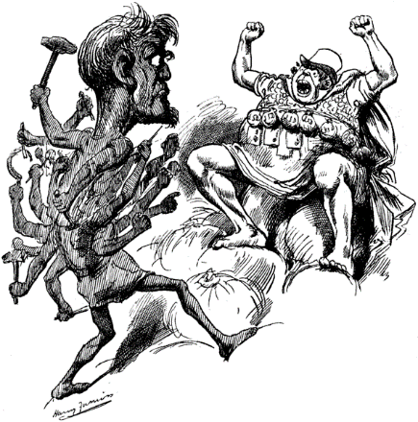
What is Hekaton?
Hekaton - "hundred“ (100) in Greek. figures in an archaic stage of Greek mythology, three giants of incredible strength and ferocity each of them having a hundred hands (100 hands working together in parallel?) and fifty heads. (Wikipedia)

Slide 6
What is Hekaton?
Hekaton is a new database engine optimized for memory resident data and OLTP workloads. It is optimized for large main memories and many-core processors. (Ohhh, and it’s fully durable!)
Hekaton’s new boring name is In-Memory OLTP.
The research and development took 5 years!
The initial goal was to gain X100 Performance improvement.

Slide 7
100

Slide 8


Slide 9
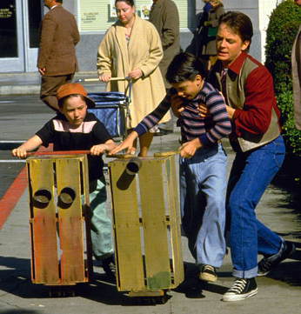
The Past
RAM prices were very high: “…In 1990 I had an IBM PC 8088 it had a 20 meg HDD. It came with 640KB RAM. It was great for the day. It cost me $3000.00…”
CPUs had a single core.
SQL Server was designed when it could be assumed that main memory was very expensive, so data needed to reside on disk (except when it was actually needed for processing) - Disk-optimized (Buffer pools, data pages, costing rules)

Slide 10
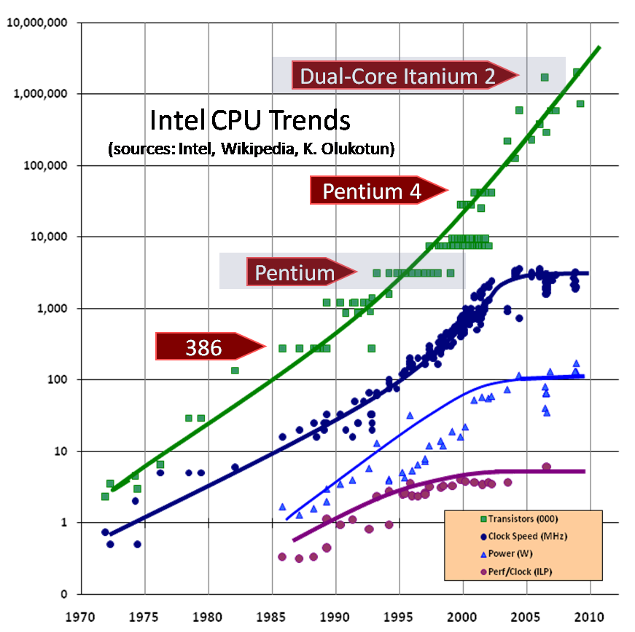
Time travel - Hardware trends
Moore’s Law on total CPU processing power holds but in parallel processing…
Decreasing RAM cost
CPU clock rate stalled…

Slide 11

Today (and also 5 years ago)
RAM prices are low, CPU cores amount is increasing: A server with 32 cores and 1TB of memory for about $50K. (50$ = HP DL980 with 2TB of RAM)
The majority of OLTP databases fit entirely in 1TB and even the largest OLTP databases can keep the active working set in memory.
Unlike “Big Data,” most OLTP data volumes are growing at more modest rates
Data management products are becoming “workload specific”
Notes:
Many of the largest financial, online retail and airline reservation systems fall between 500GB to 5TB with working sets that are significantly smaller.

Slide 12
What should we do?
Our goal is to gain a X10-100 throughput improvement. (for OLTP workloads) This cannot be achieved by optimizing existing SQL Server mechanisms.
Recognizing the trends, SQL Server began building a database engine optimized for large main memories and many-core CPU
Hekaton is not a response to competitor’s offers.

Slide 13
What is OLTP workload?
OLTP – Online transactions processing:
High concurrency
Reads and writes in the same time
Short transactions – the reliability of the data is very important
Usually working with small datasets.
Used for retail, e-commerce, gaming, Forex, tourism reservation systems etc.
As Opposed to – DWH\ reporting workload:
Writes usually happen in batches,
a single row is not important, but aggregation of many rows.
Not normalized.
Usually low concurrency.

Slide 14
Do we have to build a new engine?
Usually, OLTP Performance improvement sources were:
CPU getting faster
Software getting better
But now, CPUs are not getting any faster. DBMS have matured. Yes, we must build a new engine.

Slide 15
What should we do?
In Other words:
Specialized database engine tuned for OLTP workloads.
Fitting most or all of data required by a workload into main-memory.
Lower latency time for data operations
A new database engine optimized for memory resident data and OLTP workloads. It is optimized for large main memories and many-core processors. (don’t forget: fully durable)

Slide 16
Is it just an In-Memory DB?
DBCC PINTABLE?

Slide 17
Is it just an In-Memory DB?
CREATE TABLE [Customer] (
[CustomerID] INT NOT NULL
PRIMARY KEY NONCLUSTERED HASH WITH (BUCKET_COUNT = 1000000),
[Name] NVARCHAR(250) NOT NULL
INDEX [IName] HASH WITH (BUCKET_COUNT = 1000000),
[CustomerSince] DATETIME NULL
)
WITH
( MEMORY_OPTIMIZED = ON,
DURABILITY = SCHEMA_AND_DATA);
DBCC PINTABLE?
* Hekaton is defined at a table level.

Slide 18
A X100 performance?
How will we do it? – Architecture concepts:
Optimize indexes for main memory
Eliminate latches and locks
Compile requests to native code
*Me: Use everything the hardware has to offer (multi-cores, large memory), make it scalable and don’t keep no one waiting.
Notes:
By using the new memory-optimized tables you can speed up data access, in particular in concurrency situations, due to the lock- and latch-free architecture of the In-Memory OLTP Engine. This means that applications which suffer from a lot of contention between concurrent transactions can greatly benefit from just migrating your hot tables to memory-optimized.

Slide 19
The bottlenecks to overcome
Procedures interpretation
Latches
Concurrency Locking
Disk IO
Logging
Notes:
If most or all of an application’s data is able to be entirely memory resident, the costing rules that the SQL Server optimizer has used since the very first version become almost completely obsolete wait time required for disk reads, other wait statistics, such as waiting for locks to be released, waiting for latches to be available, or waiting for log writes to complete, can become disproportionately large.

Slide 20
The bottlenecks to overcome
Disk IO

Slide 21
Yes, In-Memory
We want to reduce
Disk IO
We can take advantage of
Low memory prices
So we will
Place all data in memory (דאאא)
Disk IO

Slide 22
Traditional DBMS
Data is saved on disk.
It is organized in 8KB pages.
Every table and index is made out of extents – 8 pages – 64 KB.
It is advised for data of a single table to reside physically next to each other.
Data is read from disk into a Buffer pool in memory (minimum of a read from disk is extent)
Every data needed for processing is read into buffer pool.
Data is also updated in the buffer pool and a process called Checkpoint writes the data back to the disk.
SQL has an algorithm that defines what pages should stay in the buffer pool and what should be removed (only in case of memory pressure)

Slide 23
Traditional DBMS
A table can be a Heap or a Clustered Index.
A heap is a lot of pages, not sorted by anything, placed in different places in the file.
A clustered Index is a B-tree that is sorted by one column (or more) and the leaf level of the tree are pages that hold the table’s data. (There can be only one clustered index on a table)
Non Clustered index ins a B-tree that is sorted by one column (or more) and the leaf level of the tree are pages that hold a pointer to the location of the row (on a Clustered index or a heap)

Slide 24
Yes, In-Memory. Memory optimized
Disk IO
The design principle: Optimizing for byte-addressable memory instead of block addressable disk, so:
Memory-optimized tables are not stored on pages like disk-based tables.
No Buffer pool.
No Clustered and non-clustered indexes: Indexes include only pointers to rows. Rows are not sorted in any way. Indexes are not pointing to other indexes.
Rows are never modified (from a different reason, will get to that)

Slide 25
Rows and Indexes
IdxB (Name)
Disk IO
Marty
IdxB pointer
IdxA pointer
Data(1955,Marty)
Einstein
Doc
…
IdxB pointer
IdxA pointer
Data(1955,Marty)
IdxA (Year)
IdxB pointer
IdxA pointer
Data(1955,Doc)
IdxB pointer
IdxA pointer
Data(1985,Marty)
1955
2014
1985
…
IdxB pointer
IdxA pointer
Data(1985,Doc)
* This is a simple representation of the row and index, the real structure holds more data and might have a different structure.
Notes:
there is no collection of pages or extents, no partitions or allocation units that can be referenced to get all the pages for a table.

Slide 26
Data storage - conclusion
Disk IO
The row is consisted from a header (will be discussed later), Index pointers and data.
Memory-optimized tables must have at least one index created on them. (the only thing connecting rows to the table is the indexes)
Records are always accessed via an index lookup.
since the number of index pointers is part of the row structure, and rows are never modified, all indexes must be defined at the time your table is created.

Slide 27
Something must be written to disk?
Disk IO
Only data rows are written to disk. (no indexes)
More on that when we talk durability.

Slide 28
The bottlenecks to overcome
Concurrency Locking

Slide 29
No more locks
We want to reduce
Lock waits
So we can take advantage of
Multiple CPU cores
So we will
Remove all locks and use MVCC
Concurrency Locking

Slide 30
Locking
In order to make sure a transaction is isolated, it reads only committed data and a row can be changed by one user at a time, we use a mechanism called locks.
Before reading or writing a row, a process needs to place lock on the row.
If there is already a lock on the row, the process needs to compare the locks for compatability.
Reads can place locks on rows that read.
Writers needs exclusive acess, so they block both readers and writers.

Slide 31
No one needs to wait
Concurrency Locking
Optimistic multi-version concurrency control.
Writers do not block readers. Writers do not block writers. No locks are acquired. Never.
Optimistic - Transactions proceed under the (optimistic) assumption that there will be no conflicts with other transactions.
Multi-version - like snapshot isolation, every transaction access only the data’s version that is correct for the time it started.
Data is never updated in place- every DML Creates a new version of the row.
This new concurrency control mechanism is built into the Hekaton data structures. It cannot be turned on or off.

Slide 32
Multi version
Concurrency Locking
Row
Header
IdxB pointer
IdxA pointer
Data
Start timestamp
End timestamp

Slide 33
Multi version
Concurrency Locking
Row
Header
IdxB pointer
IdxA pointer
Data
Start timestamp
End timestamp
Optimistic Multi-Version Concurrency control - Example
1, ∞
IdxB pointer
IdxA pointer
Marty
①

Slide 34
Multi version
Concurrency Locking
Optimistic Multi-Version Concurrency control - Example
1, ∞
IdxB pointer
IdxA pointer
Marty
②

Slide 35
Multi version
Concurrency Locking
Optimistic Multi-Version Concurrency control - Example
1, ∞
IdxB pointer
IdxA pointer
Marty
1, ∞
IdxB pointer
IdxA pointer
Marty
Tx1: Update Table1 SET Name=‘Doc’
③

Slide 36
Multi version
Concurrency Locking
Optimistic Multi-Version Concurrency control - Example
1, Tx1
IdxB pointer
IdxA pointer
Marty
1, ∞
IdxB pointer
IdxA pointer
Marty
Tx1: Update Table1 SET Name=‘Doc’
Tx1, ∞
IdxB pointer
IdxA pointer
Doc
③

Slide 37
Multi version
Concurrency Locking
Optimistic Multi-Version Concurrency control - Example
1, 3
IdxB pointer
IdxA pointer
Marty
3, ∞
IdxB pointer
IdxA pointer
Doc
③

Slide 38
Multi version
Concurrency Locking
Optimistic Multi-Version Concurrency control - Example
1, 3
IdxB pointer
IdxA pointer
Marty
3, ∞
IdxB pointer
IdxA pointer
Doc
④

Slide 39
Multi version
Concurrency Locking
Optimistic Multi-Version Concurrency control - Example
1, 3
IdxB pointer
IdxA pointer
Marty
Tx100-Read (Start time: 5) SELECT Name from Table1
3, ∞
IdxB pointer
IdxA pointer
Doc
⑤

Slide 40
Multi version
Concurrency Locking
Optimistic Multi-Version Concurrency control - Example
1, 3
IdxB pointer
IdxA pointer
Marty
Tx100-Read (Start time: 5) SELECT Name from Table1
3, ∞
IdxB pointer
IdxA pointer
Doc
⑤

Slide 41
Multi version
Concurrency Locking
Optimistic Multi-Version Concurrency control - Example
1, 3
IdxB pointer
IdxA pointer
Marty
Tx2: Update Table1 SET Name=‘Einstein’
IdxB pointer
⑥
IdxB pointer
IdxA pointer
IdxA pointer
Doc
3, ∞
Doc
3, ∞

Slide 42
Multi version
Concurrency Locking
Optimistic Multi-Version Concurrency control - Example
1, 3
IdxB pointer
IdxA pointer
Marty
Tx2: Update Table1 SET Name=‘Einstein’
IdxB pointer
⑥
IdxB pointer
IdxA pointer
IdxA pointer
Doc
3, ∞
Doc
3, Tx2
Tx2, ∞
IdxB pointer
IdxA pointer
Einstein

Slide 43
Multi version
Concurrency Locking
Optimistic Multi-Version Concurrency control - Example
1, 3
IdxB pointer
IdxA pointer
Marty
Tx200-Read (Start time: 4) SELECT Name from Table1
3, 6
IdxB pointer
IdxA pointer
Doc
⑥
6, ∞
IdxB pointer
IdxA pointer
Einstein

Slide 44
Multi version
Concurrency Locking
Optimistic Multi-Version Concurrency control - Example
1, 3
IdxB pointer
IdxA pointer
Marty
Tx200-Read (Start time: 4) SELECT Name from Table1
3, 6
IdxB pointer
IdxA pointer
Doc
⑥
6, ∞
IdxB pointer
IdxA pointer
Einstein

Slide 45
Multi version - conclusion
Concurrency Locking
All versions are equal, they act as rows and are linked to the indexes, and to one another.
To support the optimism – we validate versions for write conflict- An Attempt to update a record that has been updated since the transaction started.
A garbage collection is available to remove old rows from the memory.
The model also supports REPEATABLE READ and SERIALIZEABLE isolation levels (but that’s for another time)

Slide 46
The bottlenecks to overcome
Latches

Slide 47
No more threads waiting
We want to reduce
Latch waits
So we can take advantage of
Multiple CPU cores
So we will
Use Lock-free data structures
Latches

Slide 48
Latches
Latches
Latches are ‘region locks’: A mechanism used to protect a region of code or data structures against simultaneous thread access.
Region locks implement an ‘Acquire/Release’ pattern – where a lock is first acquired, the protected region executes, and then the lock is released.
All shared data structures must be protected with latches.
In a system with many cores or very high concurrency the region being protected becomes a bottleneck.
Highly contended resources are the lock manager, the tail of the transaction log, or the last page of a B-tree index
Notes:
Scalability suffers when the systems has shared memory locations that are updated

Slide 49

Lock free mechanism
Hekaton uses lock free data structures.
This is very complex algorithm stuff for University Professors, so will not be explained now.
Lock-free data structures truly are rocket science
They make query optimization look simple!

Slide 50
The bottlenecks to overcome
Logging

Slide 51
Logging and durability
We want to reduce
Logging and disk write time
So we can support
Durability (יציב, בר קיימא)
So we will
Minimize logging
Logging

Slide 52

Durability?
Logging
Durability was one of the main goals of the development: We want data to be available also after shutdown or unexpected crash.
RAM memory might be cheap, but it still can’t survive power outage.
Conclusion: we must write something to the disk.

Slide 53
Logging today
Because Dirty data can be written to data files by the checkpoint, we need to write in the transaction log every action and it’s UNDO information.
Data is logged by physical structure – if a row changes, we see a log record for every index on that table.

Slide 54
Logging
Logging
In order to support the high throughput, the following concepts are applied:
Index operations are not logged (No log records for physical structure modifications- Work is pushed to recovery)
No undo information is logged – only committed transactions.
Each transaction is logged in a single, potentially large, log record. (Fewer log records minimize the log-header overhead and reduce the contention for inserting into log-buffer)
Hekaton tries to group multiple log records into one large I/O.
Hekaton designed to support multiple concurrently generated log streams per database to avoid any scaling bottlenecks with the tail of the log
Combine with “Delayed Durability” (New in 2014) and you have a hover-board.
Notes:
The log contains the logical effects of committed transactions sufficient to redo the transaction. The changes are recorded as insertions and deletions of row versions labeled with the table they belong to

Slide 55
Checkpoint\Recovery
Logging
We can’t count only on T-log for durability, because no log truncation will occur and recovery will take forever.
Checkpoint files are actually a compressed version of log transactions.
Checkpointing is Optimized for sequential access (data only written, not updated or deleted)
Checkpoint related I/O occurs incrementally and continuously.
Multiple checkpoint files exist, to allow parallelism of recovery process.
Indexes are built during the recovery.

Slide 56
The bottlenecks to overcome
Procedures interpretation

Slide 57
Native compilation
We want to improve
Query speed
So we will need to
Reduce the amount of CPU instructions
So we developed
Natively compiled stored procedures
Procedures interpretation

Slide 58
Query Interpretation
Procedures interpretation
Current interpreter (Gets a physical query plan as input) is totally generic and support every table, every type etc.
It performs many run time checks during the execution of even simple statements.
It is not fast, but was fast enough when data came from disk.
Today, CPUs are not getting any faster, so
We need to lower the # of CPU instructions used to perform query processing and business logic execution.

Slide 59
Native stored procedures compilation
Procedures interpretation
The primary goal is to support efficient execution of compile-once- and-execute-many-times workloads as opposed to optimizing the execution of ad hoc queries.
Natively compiled SPs must interact with Hekaton tables only.
The In-Memory OLTP compiler leverages the query optimizer to create an efficient execution plan for each of the queries in the stored procedure.
The stored procedures is translated into C and compiled to native code (a DLL) The DLL is slim and specific for the query.

Slide 60
Improvements
Procedures interpretation
The procedure is compiled as a single function - we avoid costly argument passing between functions and expensive function calls.
Rows are not going through all operators when it’s not needed.
To avoid runtime checks: compiled stored procedures execute in a predefined security context.
Compiled stored procedures must be schema bound- to avoid costly schema locks.

Slide 61
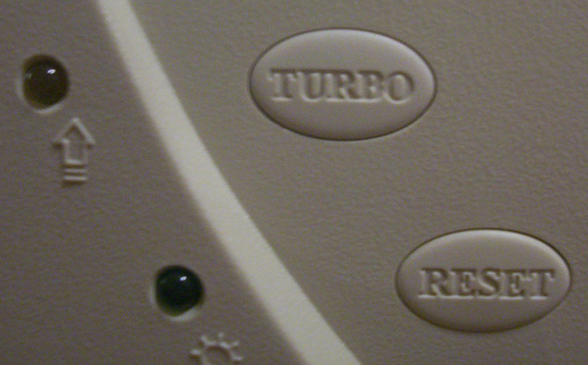
Things to remember
Procedures interpretation
Natively compiled stored procedures are not automatically recompiled if the data in the table changes.
There are some limitations on the T-SQL area surface we can use (for now)
Needs to be compiled with security context.
Using natively compiled SPs give us the biggest performance boost!

Slide 62
Conclusion
Native compiled SPs
Procedures interpretation
Minimal Logging and checkpointing
Logging
Lock-free data structures
Latches
multi-versioning Currency control
Concurrency Locking
In Memory and Memory optimized data structures
Disk IO

Slide 63
Performance results

Slide 64
CPU Efficiency for Lookups
Random lookups in a table with 10M rows
All data in memory
Intel Xeon W3520 2.67 GHz
Transaction size in #lookups | CPU cycles (in millions) |  | Speedup
 | SQL Table | Hekaton Table
1 | 0.734 | 0.040 | 10.8X
10 | 0.937 | 0.051 | 18.4X
100 | 2.72 | 0.150 | 18.1X
1,000 | 20.1 | 1.063 | 18.9X
10,000 | 201 | 9.85 | 20.4X
Hekaton performance: 2.7M lookups/sec/core

Slide 65
CPU Efficiency for Updates
Random updates, 10M rows, one index, snapshot isolation
Log IO disabled (disk became bottleneck)
Intel Xeon W3520 2.67 GHz
Transaction size in #updates | CPU cycles (in millions) |  | Speedup
 | SQL Table | Hekaton Table
1 | 0.910 | 0.045 | 20.2X
10 | 1.38 | 0.059 | 23.4X
100 | 8.17 | 0.260 | 31.4X
1,000 | 41.9 | 1.50 | 27.9X
10,000 | 439 | 14.4 | 30.5X
Hekaton performance: 1.9M updates/sec/core

Slide 66
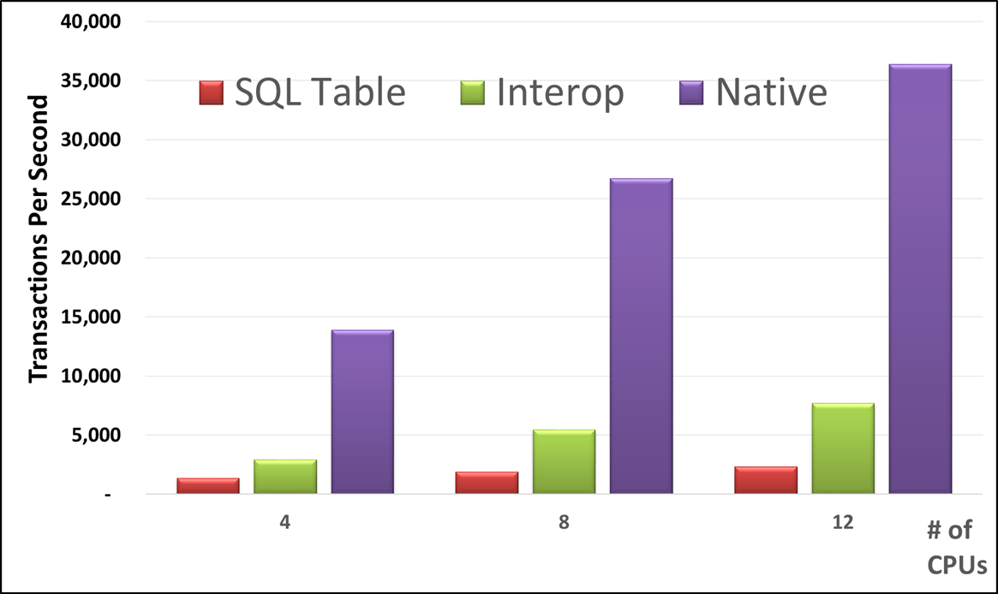
High Contention Throughput
Workload: read/insert into a table with a unique index
Insert txn (50%): append a batch of 100 rows
Read txn (50%): read last inserted batch of rows

Slide 67

More than just performance

Slide 68
SQL integration
The engine is completely integrated with SQL 2014:
No hidden licensing fees.
No need to copy data.
No need to support a new technology.
No need to maintain 2 DBs.
Migration can be done in stages.
The Hekaton engine is transparent to the application.

Slide 69
How is it integrated?
Use your existing DBs.
In-Memory tables and disk tables can be joined together easily.
Use the same installation and connection interface.
Use the same T-SQL language.
Backup the same way you always did.
Manage and maintain the DB and storage in the same way and using the same tools.
Same tools you’re used to – DMV’s, SSMS, Perf counters, resource governor…
Out-of-the-box Integration with SQL HA solutions.

Slide 70
Competitors
IBM SolidDB
Oracle TimesTen
SAP In-Memory Computing
Sybase In-Memory Databases
VoltDB

Slide 71
How to get started
Some scripts and basic knowledge

Slide 72

Migration is easy as
Identify performance bottlenecks tables, create them as Memory-Optimized and migrate data.
Upgrade your DB to run on SQL 2014 instance
Identify required code changes and Migrate procedures to native mode.
Continue querying the DB without any change using Interop mode.
No additional hardware or licensing is required. New tools helps us identify potential Hekaton tables and problems.

Slide 73
Working with Hekaton
Adding a filegroup
Migrating/ creating tables
Migrating procedures

Slide 74
Adding a filegroup DEMO

Slide 75
Memory optimized tables and indexes

Slide 76
Create Table DDL
Hash Index
BUCKET_COUNT 1-2X nr of unique index key values
CREATE TABLE [Customer](
[CustomerID] INT NOT NULL
PRIMARY KEY NONCLUSTERED HASH WITH (BUCKET_COUNT = 1000000),
[Name] NVARCHAR(250) NOT NULL,
[CustomerSince] DATETIME NULL
INDEX [ICustomerSince] NONCLUSTERED
)
WITH (MEMORY_OPTIMIZED = ON, DURABILITY = SCHEMA_AND_DATA);
Indexes are specified inline
NONCLUSTERED indexes are supported
This table is memory optimized
This table is durable

Slide 77
Memory-Optimized Indexes
Exist only in memory
Rebuilt on database startup
Do not contain data rows
Indexes contain memory pointers to the data rows
No duplication of data
All indexes are coverin (or none are covering)
Hash Indexes
Need to specify bucket_count – usually 1-2X the number of unique index keys
Optimized for point-lookups
Do not support range lookups (search on inequality predicate) or ordered scans (for ORDER BY)
Nonclustered Indexes
No need to specify any options
Optimized for range lookups and ordered scans
Support point-lookups, but hash indexes are much faster

Slide 78
Working with tables DEMO

Slide 79
Natively optimized stored procedures

Slide 80
Accessing Memory Optimized Tables
Interpreted T-SQL Access
Natively Compiled Stored Procs
Access both memory- and disk-based tables
Less performant
Virtually full T-SQL surface
When to use
Ad hoc queries
Reporting-style queries
Speeding up app migration
Access only memory optimized tables
Maximum performance
Limited T-SQL surface area
When to use
OLTP-style operations
Optimize performance critical business logic

Slide 81
Create Procedure DDL
CREATE PROCEDURE [dbo].[InsertOrder] @id INT, @date DATETIME
WITH
NATIVE_COMPILATION,
SCHEMABINDING,
EXECUTE AS OWNER
AS
BEGIN ATOMIC
WITH
(TRANSACTION
ISOLATION LEVEL = SNAPSHOT,
LANGUAGE = N'us_english')
-- insert T-SQL here
END
This proc is natively compiled
Native procs must be schema-bound
Execution context is required
Atomic blocks
Create a transaction if there is none
Otherwise, create a savepoint
Session settings are fixed at create time

Slide 82
Procedure Creation
CREATE PROC DDL
Query optimization
Code generation and compilation
Procedure DLL loaded
Procedure DLL produced

Slide 83
Working with procedures DEMO

Slide 84
Limitations on In-Memory OLTP in SQL 2014
Tables
Triggers: no DDL/DML triggers
Data types: no LOBs, no XML and no CLR data types
Constraints: no FOREIGN KEY and no CHECK constraints
No schema changes (ALTER TABLE) – need to drop/recreate table
No add/remove index – need to drop/recreate table
Natively Compiled Stored Procedures
No outer join, no OR, no subqueries, no CASE
Limited built-in functions [core math, date/time, and string functions are available]

Slide 85
Migration tools DEMO

Slide 86
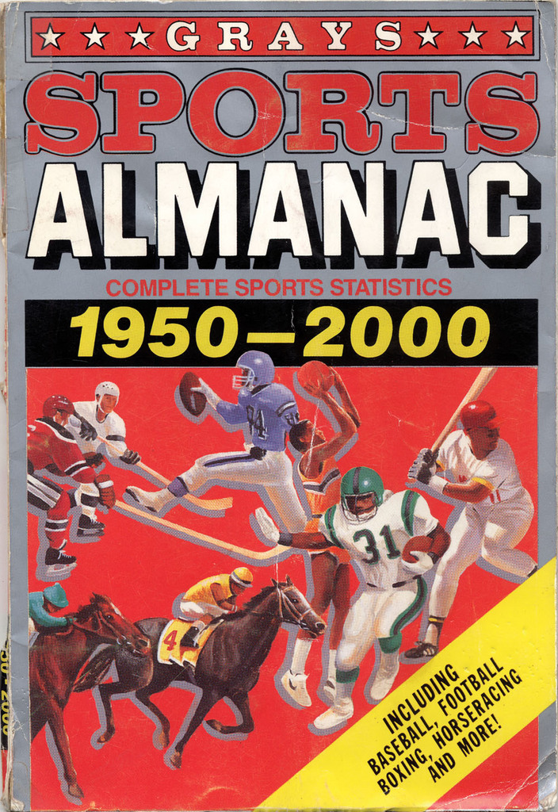
The future never looked brighter

Slide 87
Questions?
Thank you

